Slide 1
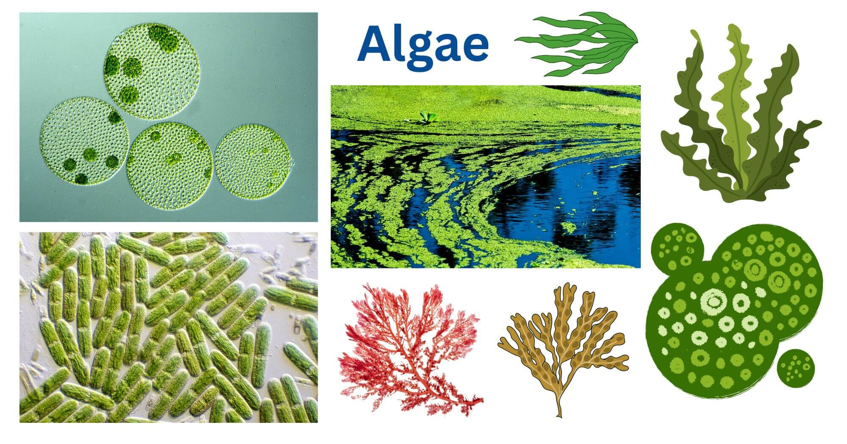
Pigmentation in Algae
Dr. Trilok Kumar
Assistant Professor
Govt. Digvijay Autonomous PG College, Rajnandgaon, C.G.

Slide 2
PIGMENTATION IN ALGAE
Algae show great diversity in pigmentation.
Different groups of algae contains different kinds of pigment.
Colour of the algal thallus (plant body) may be green, blue- green, red, brown or golden brown depending on the presence of dominant or special kinds of pigment.
Type of pigment present in the algal thallus is an important criteria for their classification.

Slide 3
Three kinds of pigments are found in algae:
1. Chlorophyll
2. Carotenoids
3. Phycobilins

Slide 4
1. Chlorophyll
Algae contains 5 different types of Chlorophyll:
Chlorophyll-a
Chlorophyll-b
Chlorophyll-c
Chlorophyll-d
Chlorophyll-e

Slide 5
Chlorophyll a - found in all photosynthetic algae
Chlorophyll b - Euglenophyta and Chlorophyta.
Chlorophyll c- Dinophyta, Cryptophyta, Heterokontophyta (Xanthophyta, Bacillariophyta, Pyrophyta, Phaeophyta, Cyanophyta).
Chlorophyll d- occurs in some Blue green algae, Rhodophyceae.
Chlorophyll e- rare and found in some golden algae (Chrysophyceae, Xanthophyceae)

Slide 6
2. Carotenoids
Carotenoids are yellow, orange, or red coloured pigment.
Carotenoids can be divided into two classes:
Carotenes: They are oxygen-free hydrocarbons.
e.g. α-carotene, β-carotene(most widespread carotene), λ-carotene, Flavicine and Lycopene
(2) Xanthophylls: oxygenated derivatives of carotenes. 20 different kinds of xanthophylls are found in different member of algae.
e.g.: Lutein, Zeaxanthin, Violaxanthin, Flavoxanthin, Neoxanthin, Diaxanthin, Astaxanthin, Taraxanthin etc.
Fucoxanthin is the principal xanthophyll in the golden- brown algae and found in (Chrysophyceae, Bacillariophyceae, Prymnesiophyceae, and Phaeophyceae), giving these algae their characteristic brown color.

Slide 7
3. Phycobilins/ Phycobiliproteins
The cyanobacteria and chloroplasts of the Rhodophyta contain phycobiliproteins.
Phycobiliproteins are water-soluble
Colours:
Blue colour pigment: Phycocyanin
Red coloured pigment: phycoerythrin
There are 3 types of phycoerythrin:
1. R-phycoerythrin - Rhodophyta
2. B-phycoerythrin - Rhodophyta
3. C-phycoerythrin - Cyanophyta
There are also 3 types of phycocyanin:
R-phycocyanin - Rhodophyta
2. C-phycocyanin - Cyanophyta
3. Allophycocyanin - Cyanophyta

Slide 8
Name of Classes of Algae on basis of Pigmentation, Reserve food material & Flagella (11 Classes according to F.E. Fritsch 1935)
CLASS | Common name | CHLOROPHYLL | CAROTENES | XANTHOPHYLL | Phycobilins | RFM | FLAGELLA | e.g.
1. Chlorophyceae | Green algae | Chll-a, Chll b | B-Carotene, Y-Carotene | Lutein, Zeaxanthin, Neoxanthin, Astaxanthin | - | Stach | 2-8 Equal | Volvox, Spirogyra, Ulva etc.
2. Xanthophyceae | Yellow-green algae | Chll-a, Chll-e | B-Carotene | Violaxanthin, Neoxanthin | - | Chrysolaminarin, Leucosin& Oil | 2 Unequal | Vaucheria, Botrydium etc.
3. Chrysophyceae | Golden-brown algae | Chll-a, Chll-c | B-Carotene | Lutein, Fucoxanthin, high conc. Of Phycochrysin | - | Chrysolaminarin, Leucosin& Oil | Absent, If present 2 Unequal | Dinobryon, Chrysosaccus etc.
4. Bacillariophyceae | Daitoms | Chll-a, Chll-c | B-Carotene | Fucoxanthin, Diataxanthin | - | Chrysolaminarin, Leucosin& Oil | Absent | Bacillaria, Pinnularia etc.
5. Cryptophyceae | Brown-orange algae | Chll-a, Chll-c | - | - | Phycoerythrin, Phycocyanin | Starch | 2 Unequal | Cryptomonas, Chroomonas etc.
6. Dinophyceae | Fire algae | Chll-a, Chll-C2 | B-Carotene | Peridinin | - | Starch, Oil & Dinosterol | 2 Equal | Ceratium, Peridinium, Gonyaulax( caused red tides, Noctiluca (Bioluminescent)
Carotenoids

Slide 9
CLASS | Common name | CHLOROPHYLL | CAROTENES | XANTHOPHYLL | Phycobilins | RFM | FLAGELLA | e.g.
7. Chloromonadineae | Raphidophytes/ Bright green algae | Chll-a, Chll b | - | High conc. Of Xanthophyyll | - | Oil | 2 Equal | Trentonia, Gonyostomum etc.
8. Euglenophyceae | Euglenoidae | Chll-a, Chll-b | B-Carotene | Astaxanthin, Diadinoxanthin | - | Carbohydrate- Paramylon or Paramylum (Polymer of B-1,3 glucan), Lipid | 2 Unequal | Euglena, Phacus, Peranema etc.
9. Phaeophyceae | Brown algae | Chll-a, Chll-c | B-Carotene | High conc. Of Fucoxanthin, | - | Chrysolaminarin, Leucosin& Oil | 2 Unequal | Ectocarpus, Fucus etc.
10. Rhodophyceae | Red algae | Chll-a, Chll-d | B-Carotene | Some Xanthophyll | High conc. Of r-Phycoerythrin, r-Phycocyanin | Floridian starch | Absent | Polysiphonia, Gracilaria etc.
11. Cyanophyceae/ Myxophyceae | Blue green algae (BGA)/ Cyanobacteria | Chll-a | B-Carotene | Lutein | High conc. Of c-Phycocyanin & c-Phycoerythrin | Cyanophycean Starch | Absent | Nostoc, Oscillatoria, Anabaena Spirulina etc.
Carotenoids

